Slide 1
ANLP

Slide 2
Neural Computational Morphology
Garrett Bingham

Slide 3
Outline
Introduction to Morphology
What is Morphology?
Motivation for NLP
Important Topics Crash Course
Convolutional Neural Networks
Long Short-Term Memory
Word Embeddings
Paper Summaries
Cross-lingual, Character-Level Neural Morphological Tagging
Unsupervised Morphology Induction Using Word Embeddings
Conclusion
Discussion
References
Notes:
Please ask questions at any point.
Throughout this presentation: if you know a language and how a concept applies, please give an example!
These examples can be illustrative and they demonstrate why morphological analysis is important.

Slide 4
Introduction to Morphology

Slide 5
Important Concepts
Concept | Definition | Example
Word-form | A word as it occurs in speech or text | I ate the cake.
Lexeme | A set of word-forms | eat = {eat, eats, eaten, ate}
Lemma | A word-form chosen by convention to represent a lexeme | Lemma for any word-forms in eat is typically eat.
Morpheme | The smallest part of a word that has meaning | Undecidable = un + decide + able Spanish: dámelo = da + me + lo → give + me + it = give it to me
Important! eat and eater belong to different lexemes, since they represent different concepts.
[3]
Notes:
Summarize Table
Morphological analysis deals with text at the morpheme level
Important for low-resource and morphologically rich languages

Slide 6
Morphemes
Free morphemes can occur by themselves as a word.
Bound morphemes must be attached to a word to have any meaning.
Different languages construct words from morphemes in different ways.
[5]
Notes:
Free/bound example: can anyone think of one? Quick+ly = bound + free.
The variation can make it difficult to model

Slide 7
Types of Languages
Type | Definition | Example
Isolating | Bound morphemes are not allowed to attach to words | Mandarin Chinese (with some small exceptions)
Agglutinative | Multiple bound morphemes can attach to a free morpheme. Each morpheme usually conveys one piece of information. | Hungarian: egészségedre egész = whole -ség = -ness -ed = your -re = to → To your health = cheers
Inflectional | A single bound morpheme conveys multiple pieces of information | Spanish: dormiste (you slept) -iste conveys second person singular past (preterite) tense
[5]
Notes:
Examples of how different languages use bound/free morphemes to modify words and create meaning

Slide 8
Morphological Processes
Process | Definition | Example
Inflectional Morphology | Words are modified so that they can be properly used in the context. | English: third person singular in present tense requires +s Sleep → he/she sleeps
Derivational Morphology | A new word is derived from the original word. The new word can be of a different part-of-speech. | sleep → sleepless → sleeplessness noun adjective noun
Compounding | Concatenation of free morphemes | English: firefighter, playground, etc. German: Lebensversicherungsgesellschaftsangesteller = Leben, Versicherung, Gesellschaft, Angesteller
[5]

Slide 9
Motivation for NLP
Morphologically rich languages
Low-resource languages
Rare words
Relations between words
Better performance on NLP tasks
Notes:
Many tasks that don’t require morphological analysis for English do for other languages
Morphological analysis helps us get even more meaning for low-resource languages
Rare words: we can use morphology to infer the meaning from the base word + some morphological transformations

Slide 10
Hungarian Grammar for Beginners
holy / saint | szent
holiness | szentség
unholy | szentségtelen
to make something unholy = to desecrate | megszentségtelenít
being unable to desecrate | megszentségteleníthetetlenség
doing something that’s unable to desecrate | megszentségteleníthetetlenségeskedés
your actions while doing something that’s unable to desecrate | megszentségteleníthetetlenségeskedéseitek
for your actions while doing something that’s unable to desecrate | megszentségteleníthetetlenségeskedéseitekért
Notes:
If you didn’t have morphological info and you encountered megszent….. Out of nowhere, how would you know what it meant?
All words are crazy long → illustration of why this is important

Slide 11
Important Topics Crash Course

Slide 12
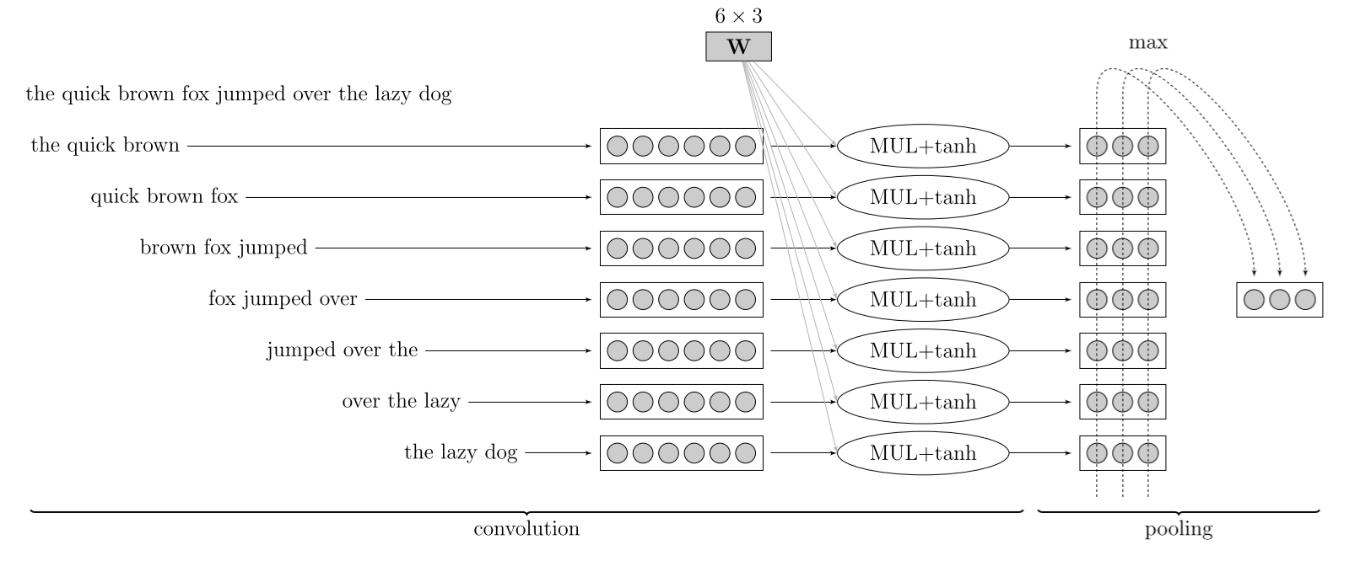
Convolutional Neural Networks (CNN)
Sliding window followed by pooling operation
Produces vector representation that captures the most informative local features
Effective for arbitrarily large input
Sensitive to local word order
[2]

Slide 13


Long Short-Term Memory (LSTM)
Capable of learning long-term dependencies
A persistent cell state (top line in the diagram) serves as a “memory”
At each iteration, information can be forgotten from or added to the cell state
Many LSTM variations exist
[6]
Notes:
Possible to remember certain info for arbitrarily long

Slide 14
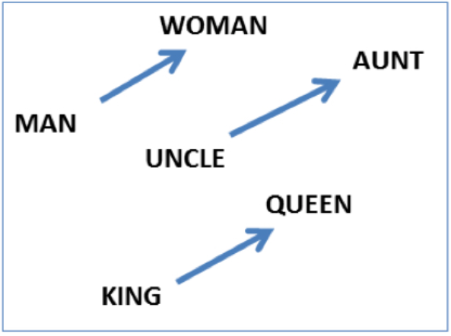
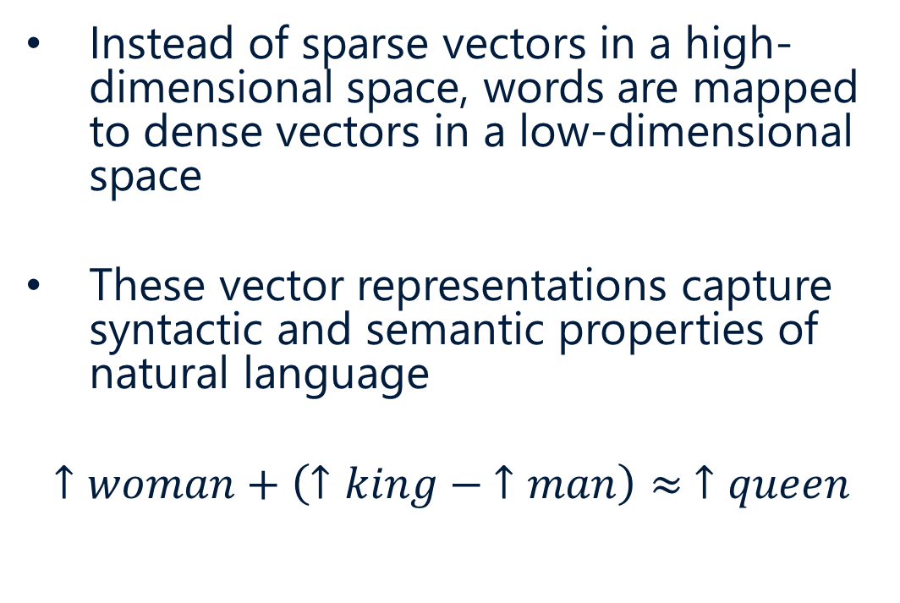
Word Embeddings
Instead of sparse vectors in a high-dimensional space, words are mapped to dense vectors in a low-dimensional space
These vector representations capture syntactic and semantic properties of natural language
$$↑woman+\left(↑king − ↑man\right)≈ ↑queen$$
Image courtesy of Jurafsky & Martin
Notes:
We can exploit these relationships to learn info about the words (esp. new/rare words).

Slide 15
Paper Summaries
Notes:
Before we go to the papers, any questions?

Slide 16
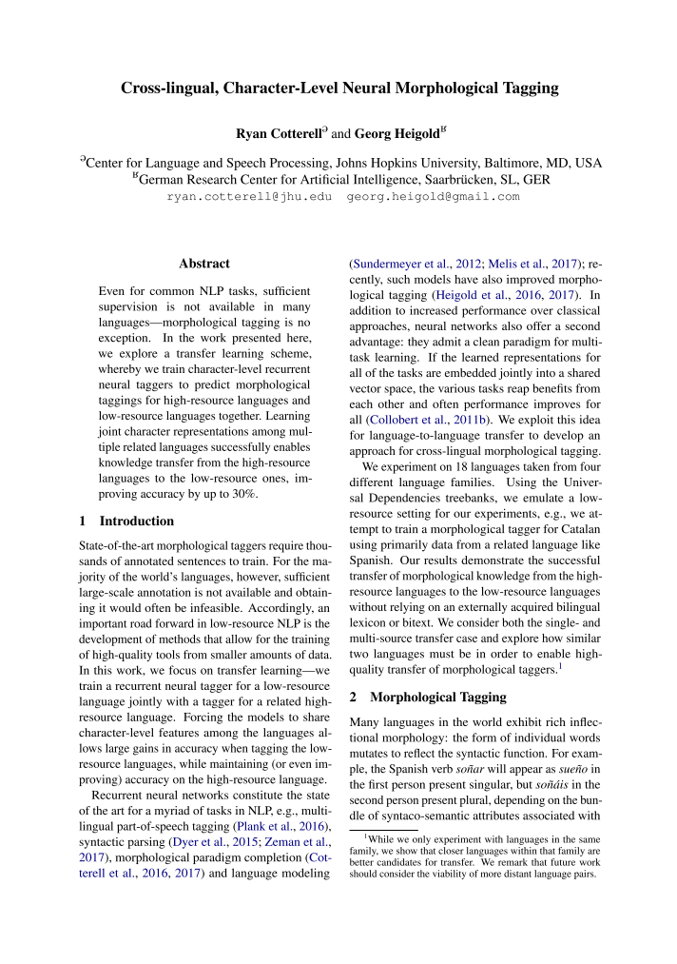
Cross-lingual, Character-Level Neural Morphological Tagging
“Even for common NLP tasks, sufficient supervision is not available in many languages—morphological tagging is no exception. In the work presented here, we explore a transfer learning scheme, whereby we train character-level recurrent neural taggers to predict morphological taggings for high-resource languages and low-resource languages together. Learning joint character representations among multiple related languages successfully enables knowledge transfer from the high-resource languages to the low-resource ones, improving accuracy by up to 30%.”
Cotterell and Heigold, 2017.
[1]
Notes:
Cotterell+heigold.emnlp17

Slide 17
Morphological Tags
A morphological tag is a symbol which encodes morphological properties of a word.
The size of the tagset depends on the language.
The Penn tagset (American English) has 36 tags.
Example tag: VBD = verb in past tense
The Czech positional tagset has roughly 4000 tags
Example tag: VpNS---XR-AA--- corresponds to
(verb, participle, neuter, singular, any person, past tense, active, affirmative)
[4]
Notes:
Input is some text
Correct labels are these tags

Slide 18
Motivation
State-of-the-art morphological taggers require thousands of training sentences
This is not available for many languages
Jointly training a high and low-resource language in a shared vector space allows transfer of information.
Notes:
Like we mentioned earlier: the vector space captures syntactic and semantic information.

Slide 19
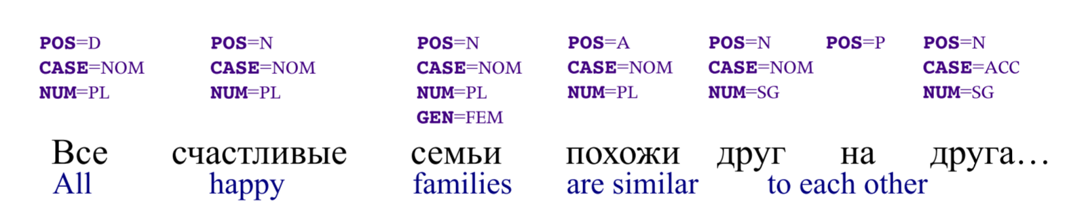
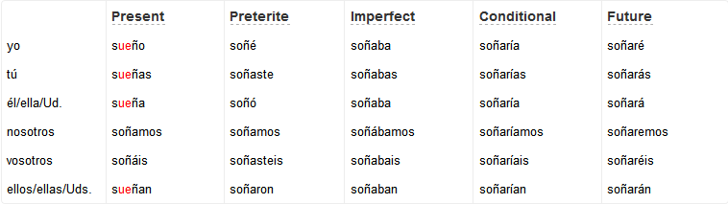
Examples
spanishdict.com, [1]
Notes:
Example Russian morphologically-tagged sentence.
Partial inflection table for Spanish verb soñar (to dream).

Slide 20
Transferring Morphology
Unlike part-of-speech, which is relatively universal, morphology is highly language-dependent.
Example: Hungarian nouns can exhibit 17 different “cases,” Slavic verbs two “aspects,” while English distinguishes neither of these.
The effectiveness of the morphological transfer will depend on how related the two languages are.
[1]
Notes:
Example: Spanish sueño → dream
But dream → ? (it could be multiple).

Slide 21
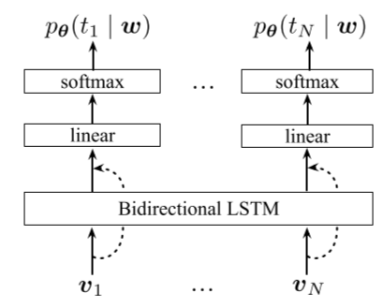
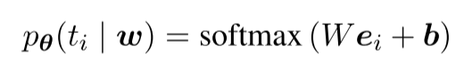
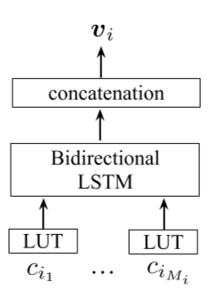
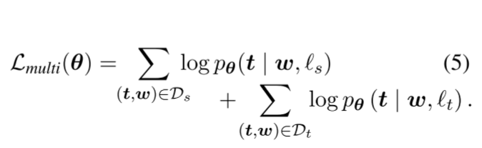
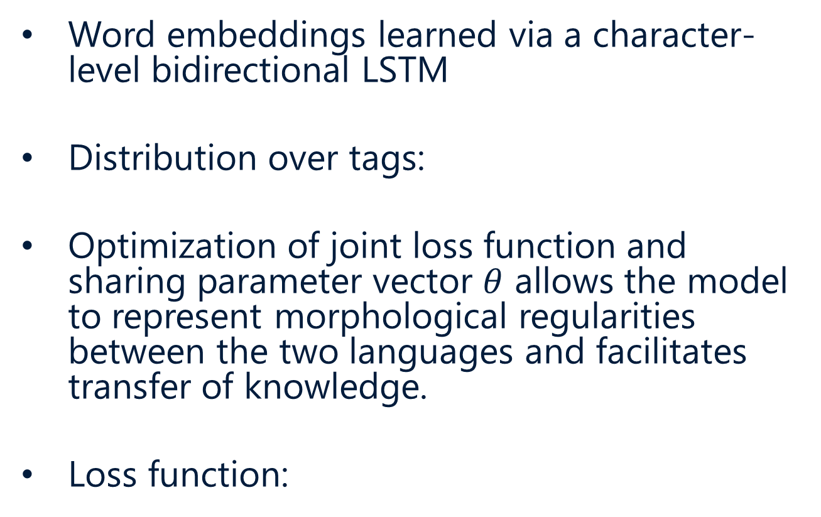
Standard Architecture
Word embeddings learned via a character-level bidirectional LSTM
Distribution over tags:
Optimization of joint loss function and sharing parameter vector $θ$ allows the model to represent morphological regularities between the two languages and facilitates transfer of knowledge.
Loss function:
[1]
Notes:
Probability of tag i given words w
Loss function for Ds (source) and Dt (target) languages
There are 3 variations on this standard architecture
Each forces the model to learn language-specific features in a different way

Slide 22
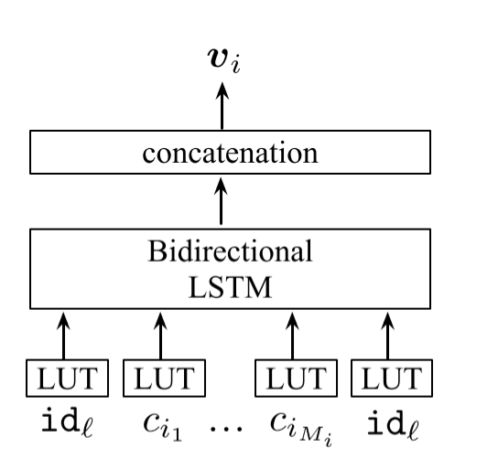
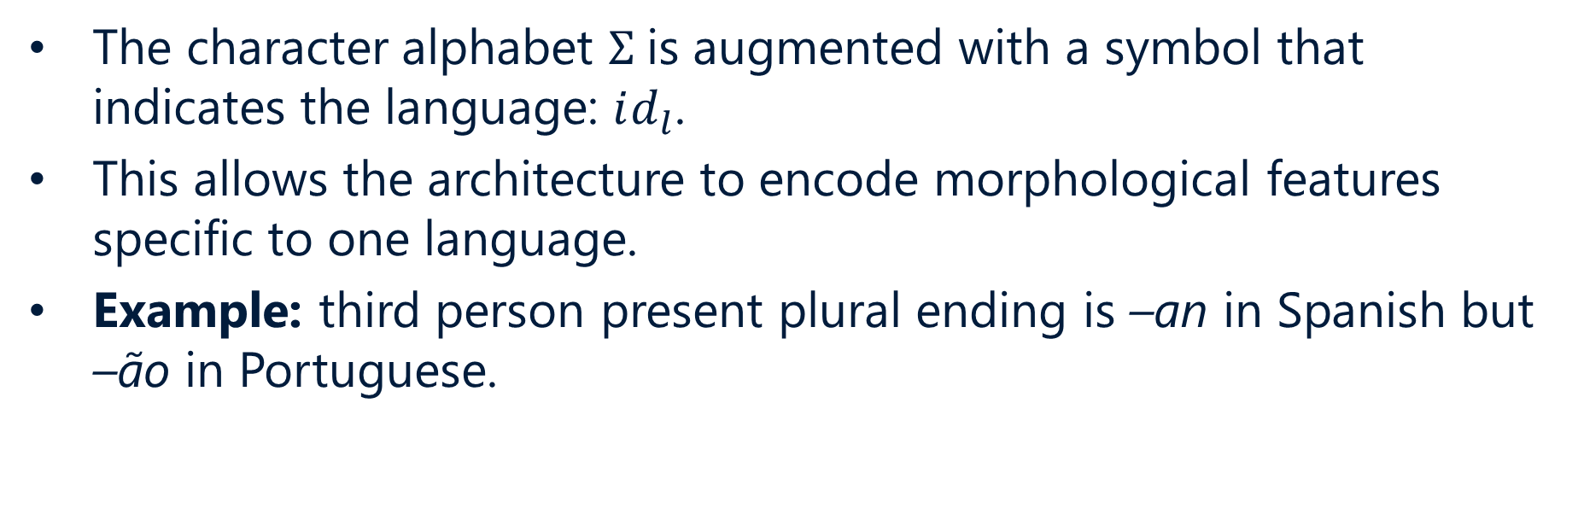
Variation #1: Language-Specific Embeddings
The character alphabet $Σ$is augmented with a symbol that indicates the language: $id_{l}$.
This allows the architecture to encode morphological features specific to one language.
Example: third person present plural ending is –an in Spanish but –ão in Portuguese.
[1]

Slide 23
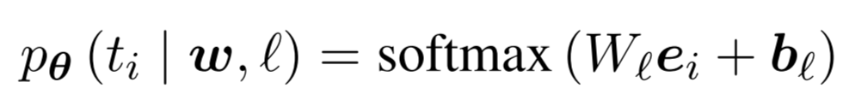
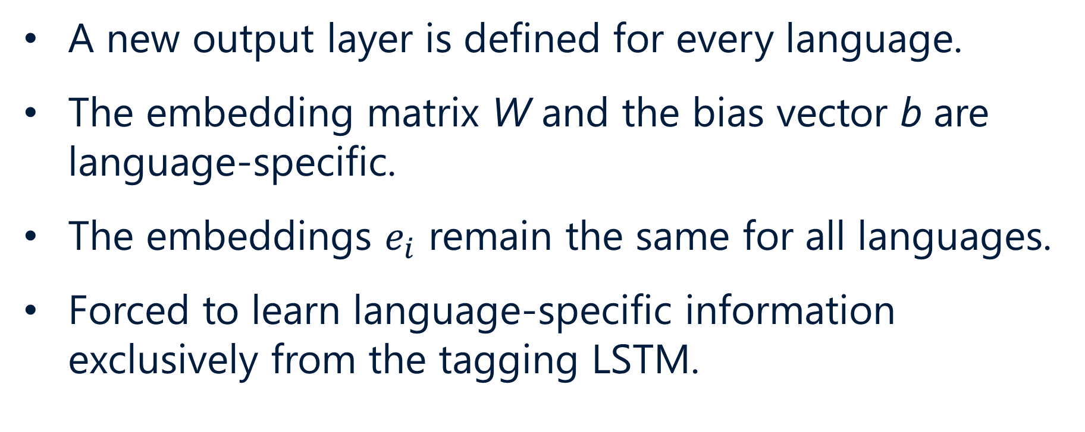
Variation #2: Language-Specific Softmax
A new output layer is defined for every language.
The embedding matrix W and the bias vector b are language-specific.
The embeddings $e_{i}$ remain the same for all languages.
Forced to learn language-specific information exclusively from the tagging LSTM.
[1]
Notes:
First architecture integrates knowledge at a lower level, the second at a higher level.

Slide 24
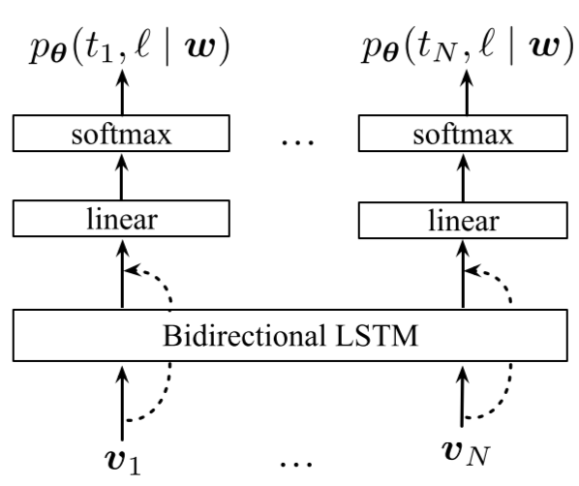
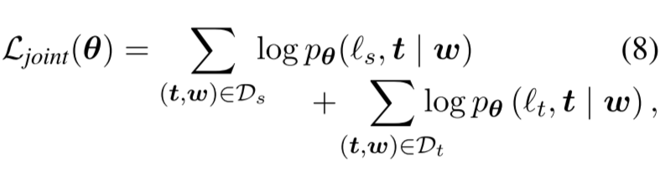
Variation #3: Joint Tagging and Language Identification
Instead of conditioning on the language, the language is predicted.
Allows morphological analysis when the language is unknown.
This requires a new loss function:
[1]

Slide 25
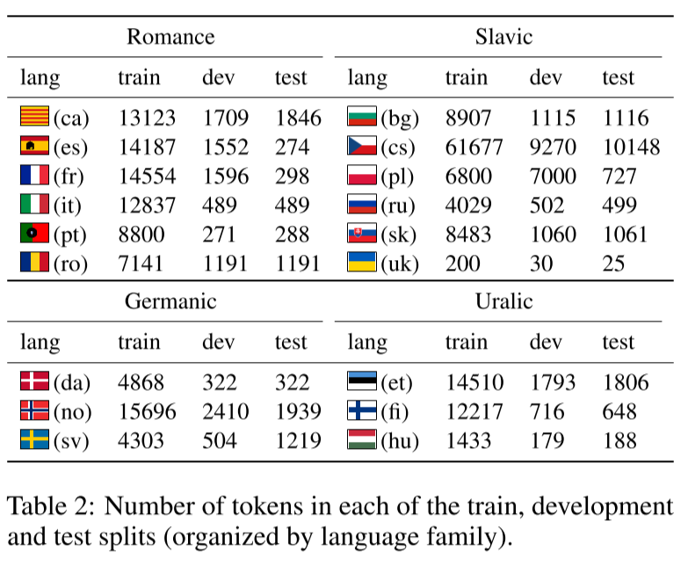
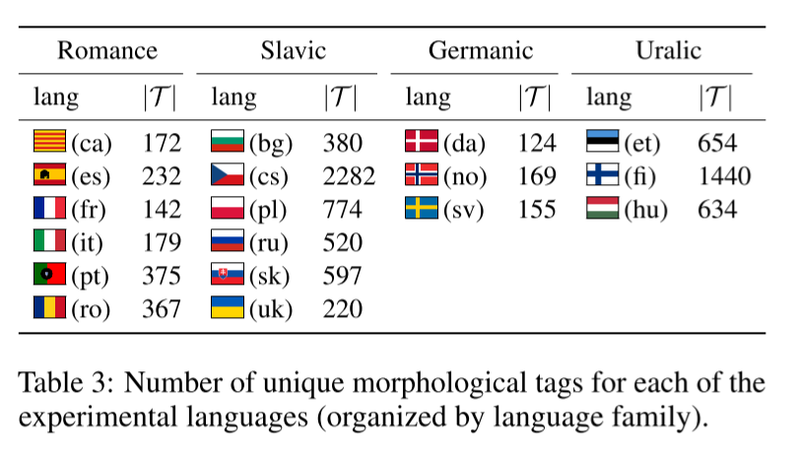
Datasets
From the Universal Dependencies treebanks
[1]
Notes:
Notice how low-resource some of the languages are (ukranian almost has more tags than tokens)
Also notice that some languages (Czech, Finnish) have a lot of morphological tags

Slide 26
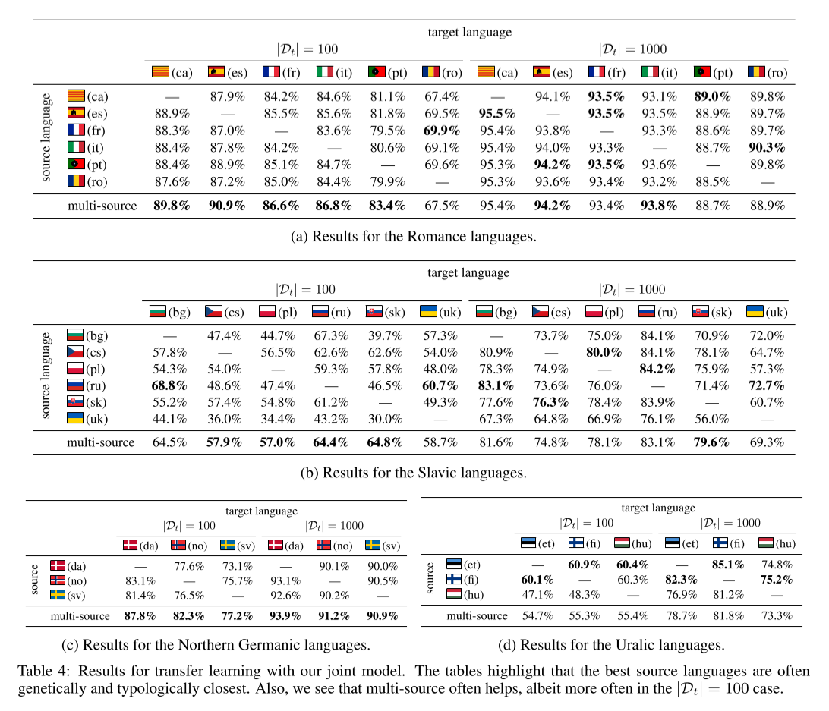
Results
Morphological transfer is more successful among similar languages.
[1]
Notes:
Look how difficult it is to correctly tag morphologically rich languages! (Czech, Finnish, Hungarian, etc.)

Slide 27
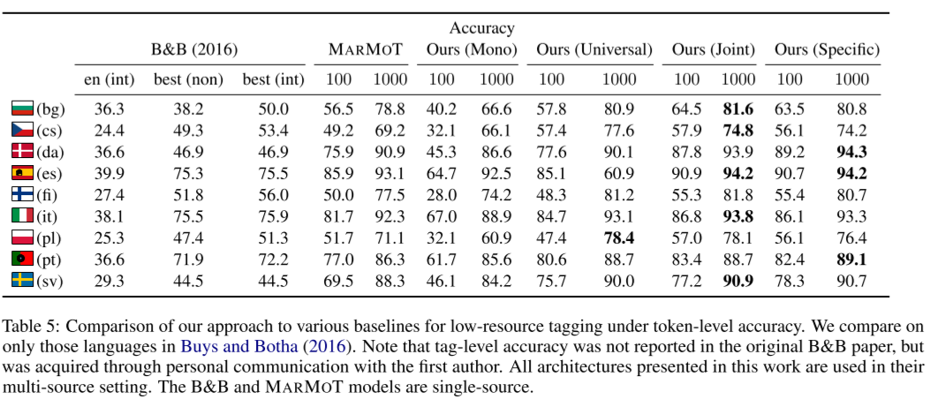
Results
[1]
Notes:
Per token accuracy
Must get all attributes correct per token

Slide 28
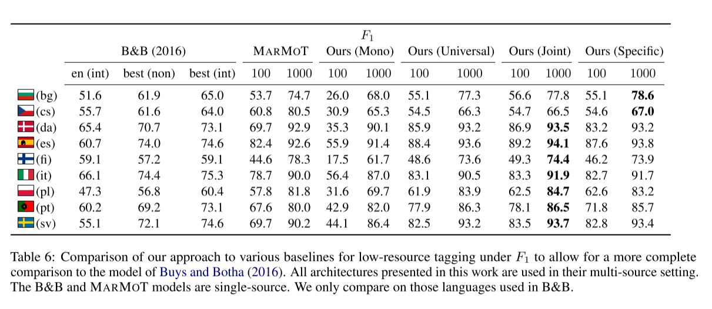
Results
[1]
Notes:
F1 is per feature accuracy
It gives partial credit for getting some attributes correct

Slide 29
Recap
Transfer learning allows the model to learn from a high-resource language in order to better morphologically tag a low-resource language
Morphology transfer is more effective for related languages
[1]
Notes:
Any questions about this paper before we move on to the next?

Slide 30
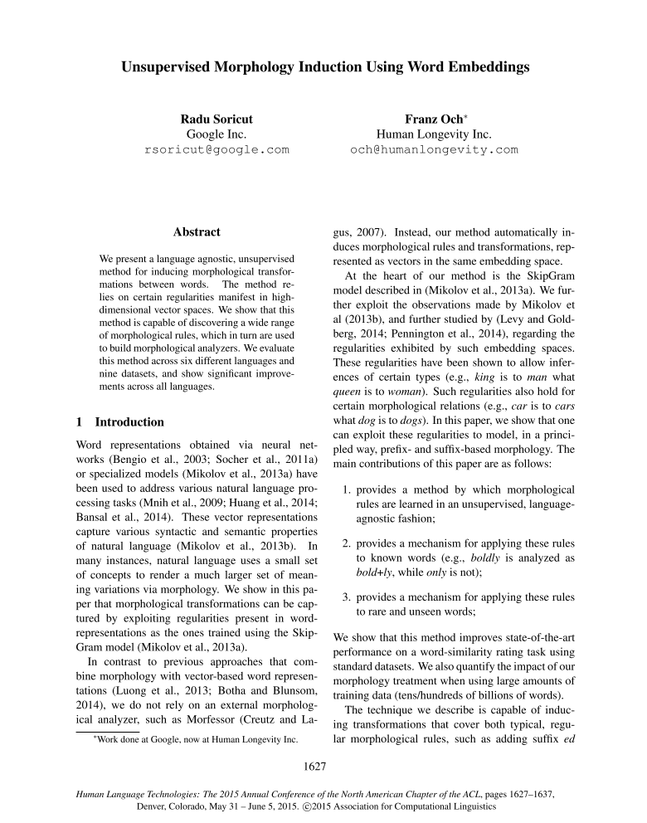
Unsupervised Morphology Induction Using Word Embeddings
“We present a language agnostic, unsupervised method for inducing morphological transformations between words. The method relies on certain regularities manifest in high-dimensional vector spaces. We show that this method is capable of discovering a wide range of morphological rules, which in turn are used to build morphological analyzers. We evaluate this method across six different languages and nine datasets, and show significant improvements across all languages.”
Soricut and Och, 2015.
[7]

Slide 31
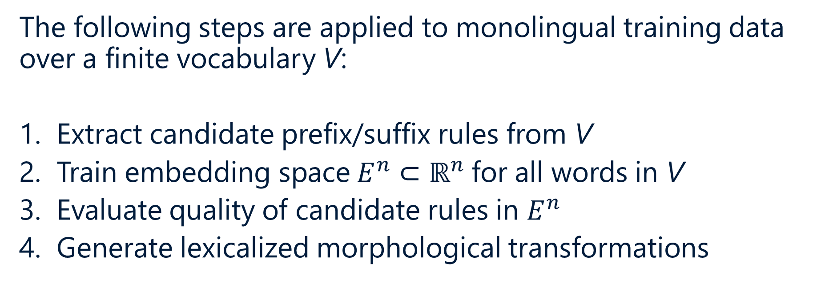
Overview of Algorithm
The following steps are applied to monolingual training data over a finite vocabulary V:
Extract candidate prefix/suffix rules from V
Train embedding space$E^{n}⊂ℝ^{n}$for all words in V
Evaluate quality of candidate rules in $E^{n}$
Generate lexicalized morphological transformations
[7]
Notes:
We’ll go over each of these in more detail

Slide 32
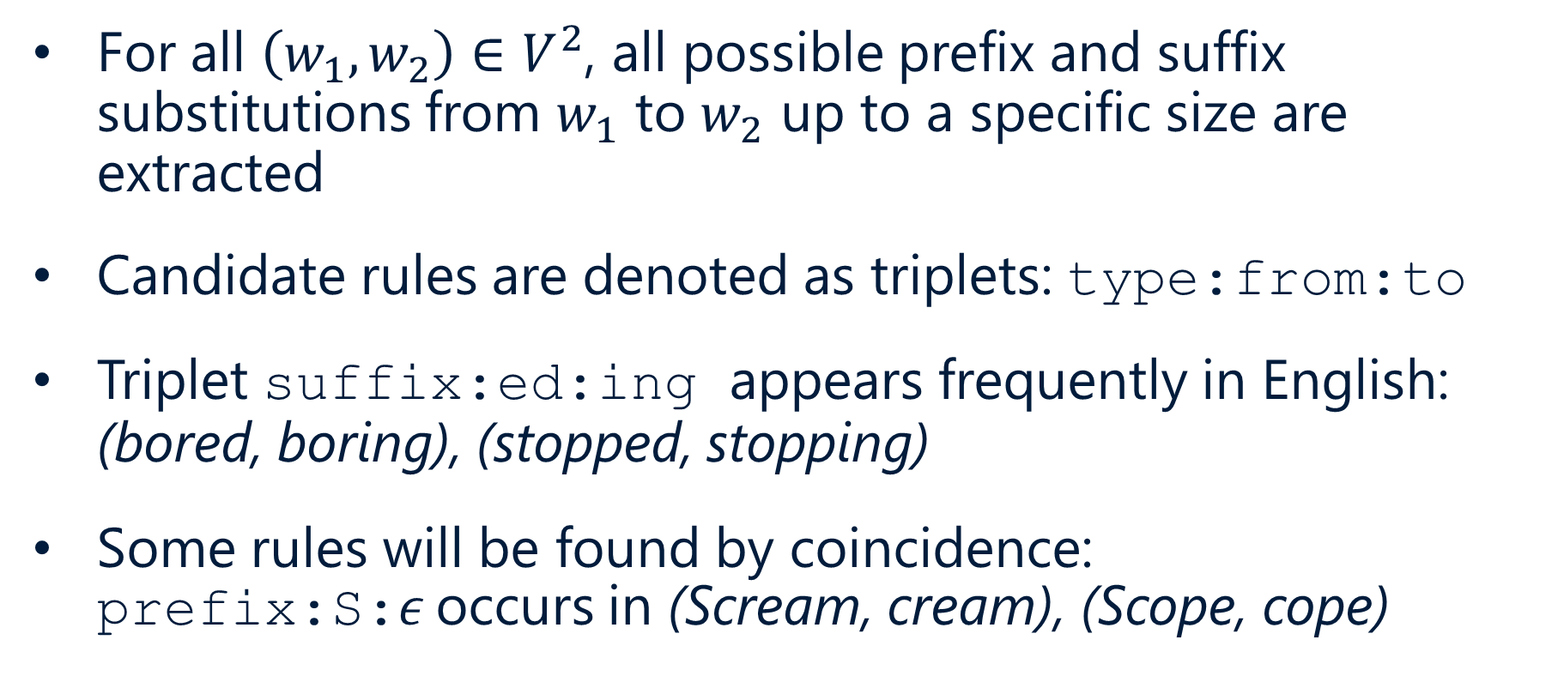
1. Extract Candidate Rules
For all $\left(w_{1},w_{2}\right)∈V^{2}$, all possible prefix and suffix substitutions from $w_{1}$ to $w_{2}$ up to a specific size are extracted
Candidate rules are denoted as triplets: type:from:to
Triplet suffix:ed:ing appears frequently in English: (bored, boring), (stopped, stopping)
Some rules will be found by coincidence: prefix:S:$ε$occurs in (Scream, cream), (Scope, cope)
[7]
Notes:
Specified size: authors use 6

Slide 33
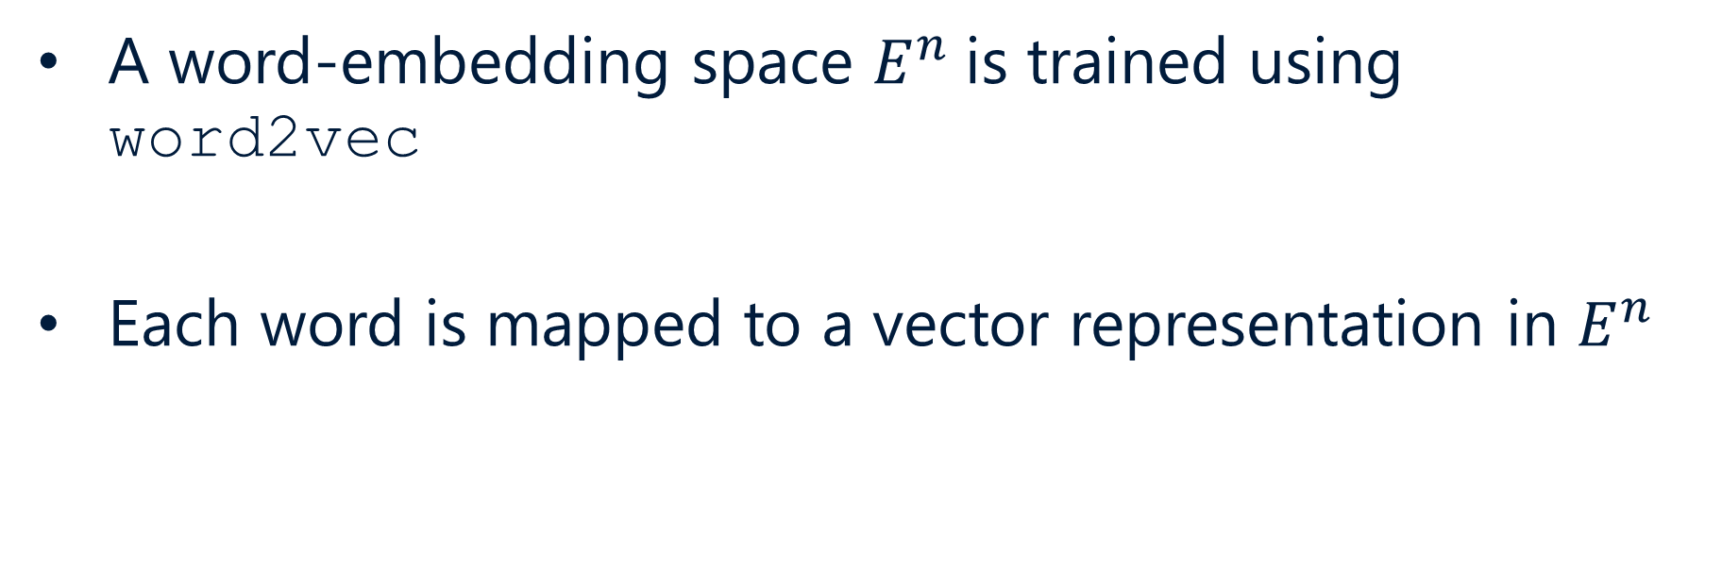
2. Train Embedding Space
A word-embedding space $E^{n}$is trained using word2vec
Each word is mapped to a vector representation in $E^{n}$
[7]

Slide 34
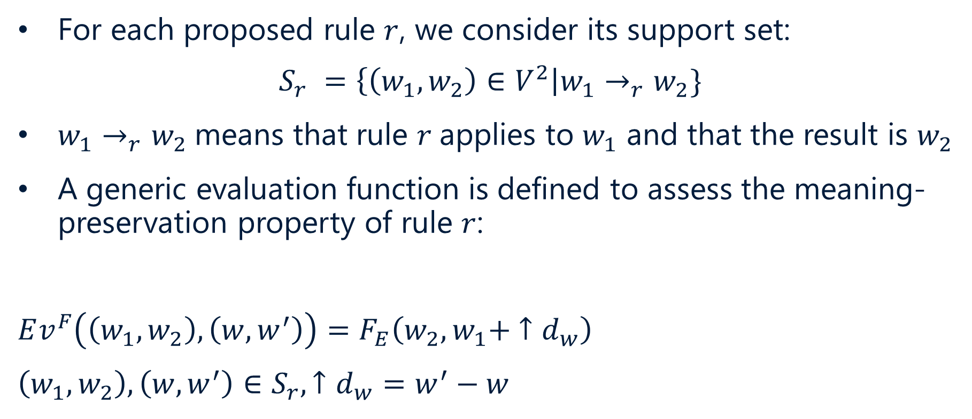
3. Evaluate Candidate Rules
For each proposed rule $r$, we consider its support set:
$$S_{r} =\left\{\left(w_{1},w_{2}\right)∈V^{2}\right|w_{1}→_{r}w_{2}\}$$
$w_{1}→_{r}w_{2}$means that rule $r$applies to $w_{1}$ and that the result is $w_{2}$
A generic evaluation function is defined to assess the meaning-preservation property of rule $r$:
$$Ev^{F}\left(\left(w_{1},w_{2}\right),\left(w,w^{′}\right)\right)=F_{E}\left(w_{2},w_{1}+ ↑d_{w}\right)$$
$$\left(w_{1},w_{2}\right),\left(w,w^{′}\right)∈S_{r}, ↑d_{w}=w^{′}−w$$
Jurafsky & Martin, [7]
Notes:
Instead of man → woman, consider:
Quick → quickly
Smart → smartly
NOT like on → only

Slide 35
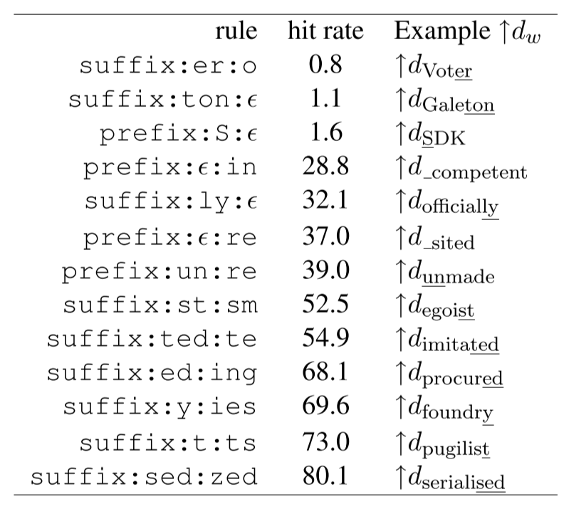
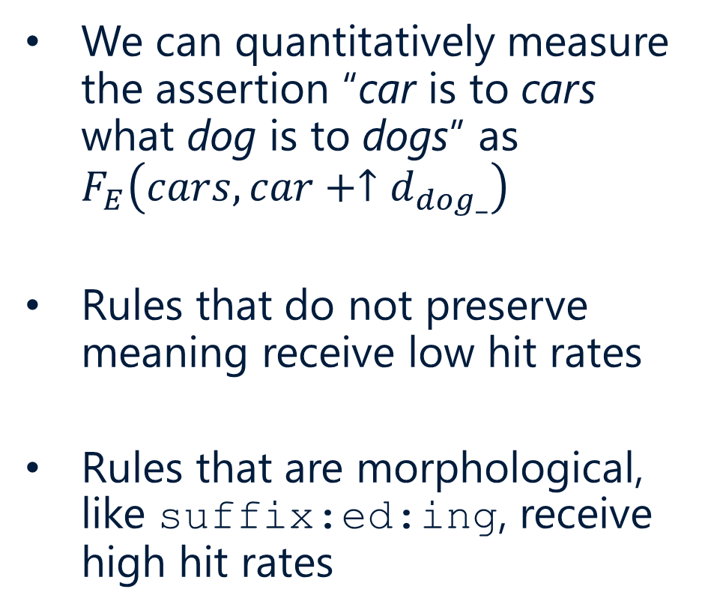
3. Evaluate Candidate Rules (cont.)
We can quantitatively measure the assertion “car is to cars what dog is to dogs” as $F_{E}\left(cars, car+↑d_{dog_}\right)$
Rules that do not preserve meaning receive low hit rates
Rules that are morphological, like suffix:ed:ing, receive high hit rates
[7]
Notes:
Car → cars is noun pluralization transformation

Slide 36
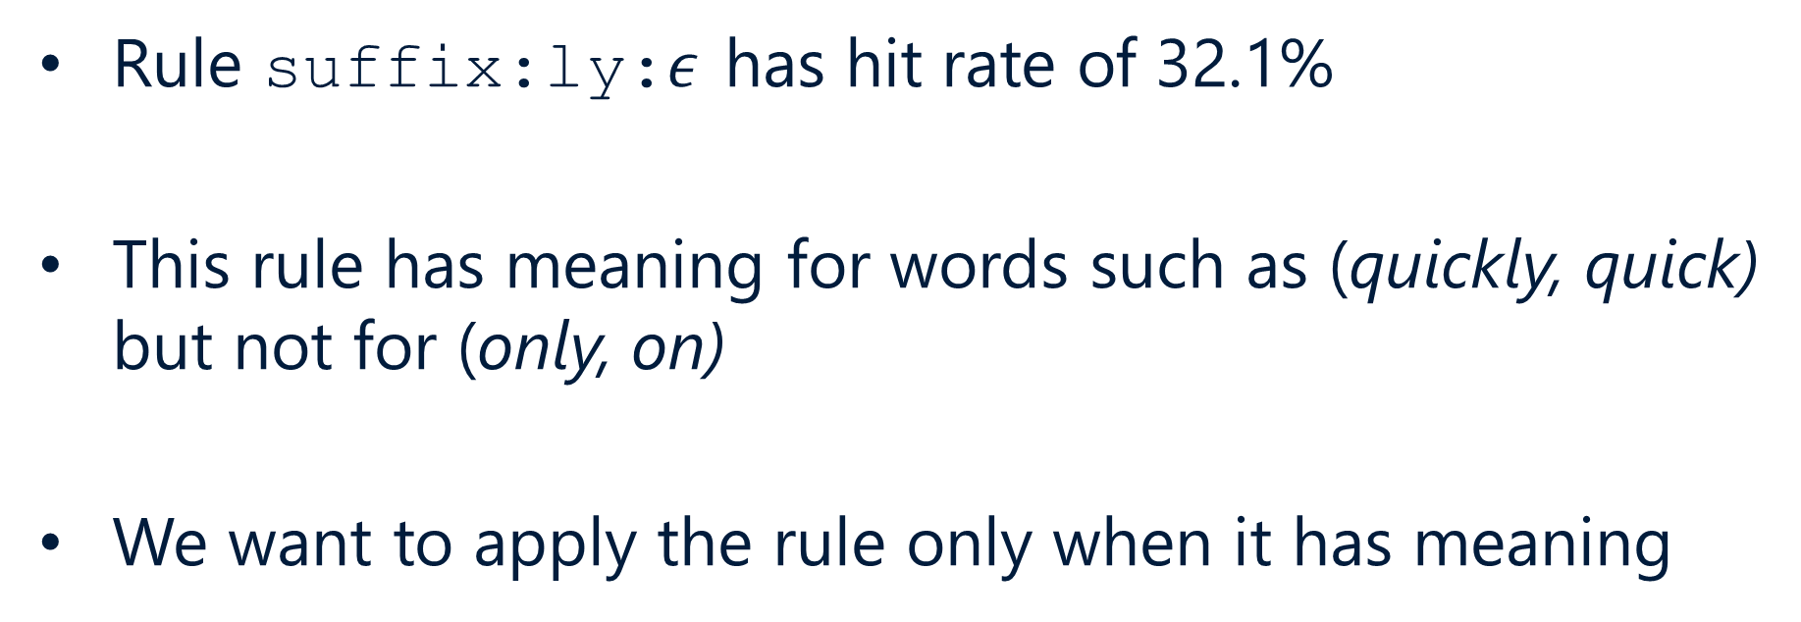
4. Generate Lexicalized Transformations
Rule suffix:ly:$ε$ has hit rate of 32.1%
This rule has meaning for words such as (quickly, quick) but not for (only, on)
We want to apply the rule only when it has meaning
[7]
Notes:
We don’t want to totally throw it away, it’s important (adverb → adjective)
Learning when/how to apply the transformation is what we do next.

Slide 37
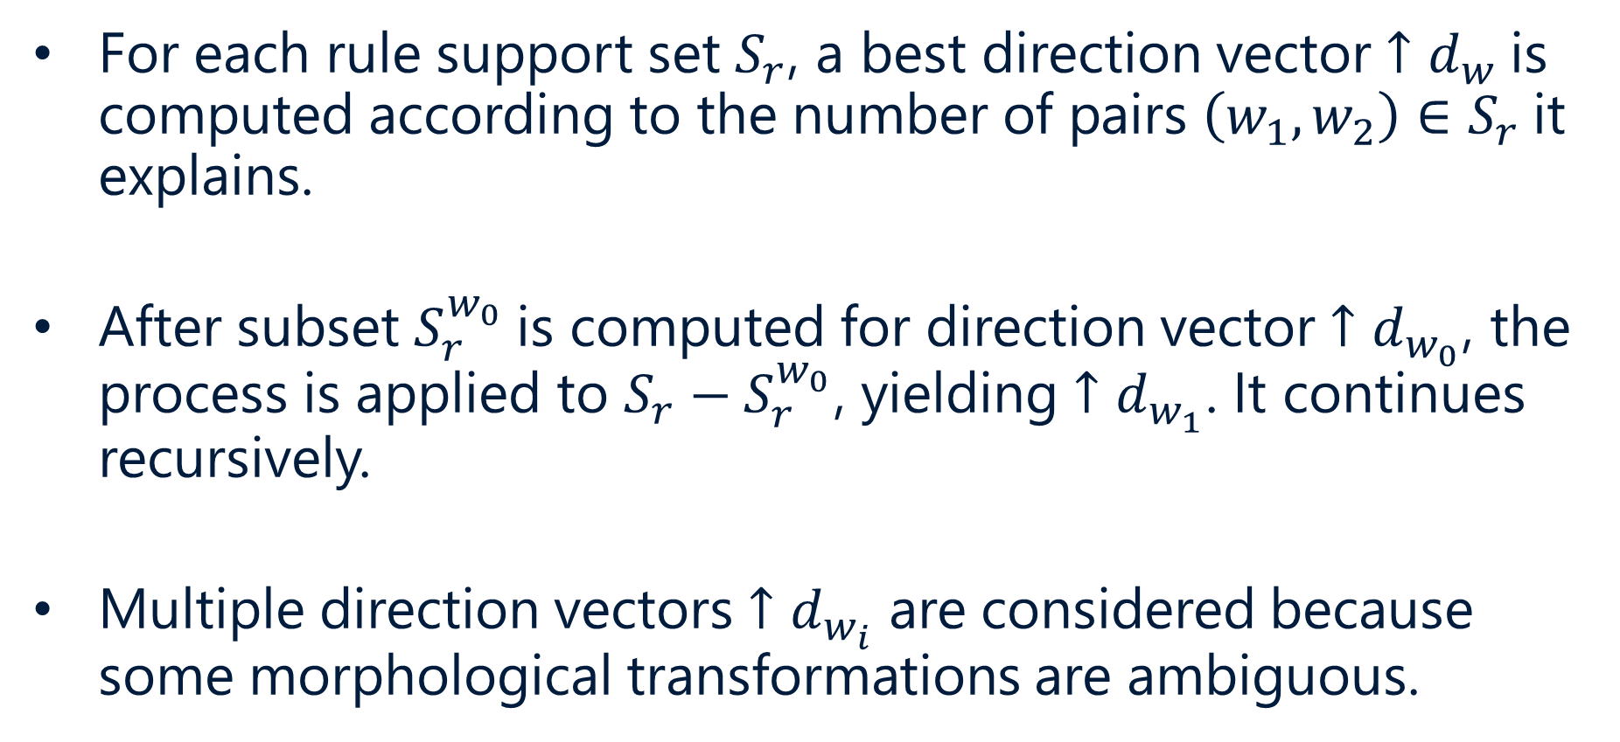
4. Generate Lexicalized Transformations (cont.)
For each rule support set $S_{r}$, a best direction vector $↑d_{w}$is computed according to the number of pairs $\left(w_{1},w_{2}\right)∈S_{r}$it explains.
After subset $S_{r}^{w_{0}}$is computed for direction vector $↑d_{w_{0}}$, the process is applied to $S_{r}−S_{r}^{w_{0}}$, yielding $↑d_{w_{1}}$. It continues recursively.
Multiple direction vectors $↑d_{w_{i}}$ are considered because some morphological transformations are ambiguous.
[7]
Notes:
Ambiguous transformation examples: next slide

Slide 38
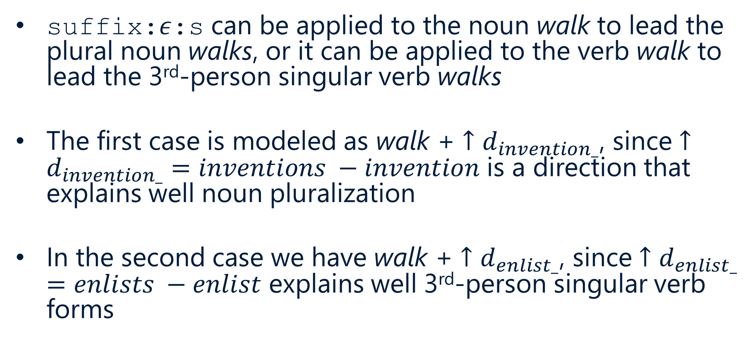
4. Generate Lexicalized Transformations (cont.) (cont.)
suffix:$ε$:s can be applied to the noun walk to lead the plural noun walks, or it can be applied to the verb walk to lead the 3rd-person singular verb walks
The first case is modeled as walk + $↑d_{invention_}$, since $↑d_{invention_}$ $=inventions −invention$ is a direction that explains well noun pluralization
In the second case we have walk + $↑d_{enlist_}$, since $↑d_{enlist_}$ $=enlists −enlist$ explains well 3rd-person singular verb forms
[7]

Slide 39
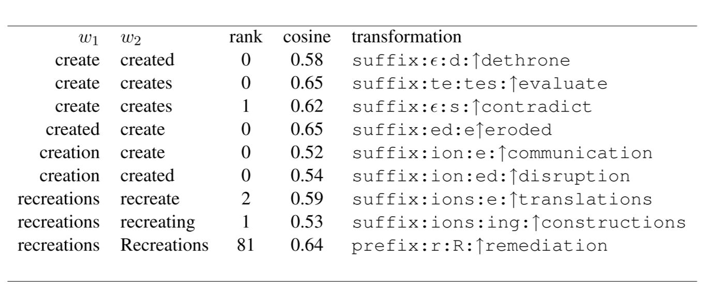
4. Generate Lexicalized Transformations (cont.) (cont.) (cont.)
Lexicalized rules combined with direction vectors are called morphological transformations
[7]
Notes:
Rank/cosine are just different ways to evaluate how good it is (low rank, high cosine is good)

Slide 40
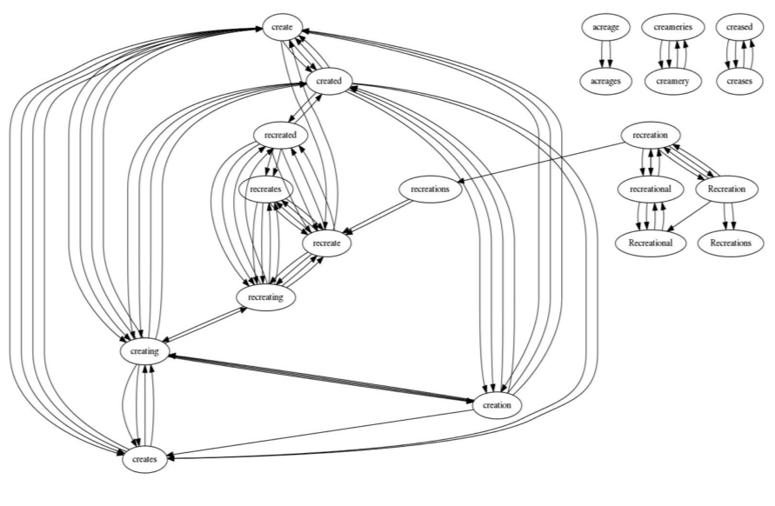
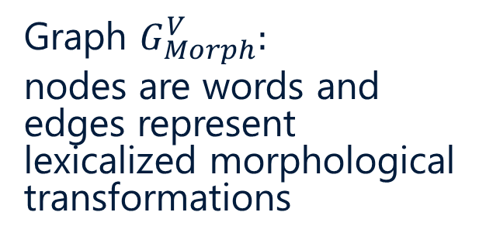
4. Generate Lexicalized Transformations (cont.)⁴
Graph $G_{Morph}^{V}:$
nodes are words and edges represent lexicalized morphological transformations
[7]
Notes:
Strongly connected components represent families of morphological variations
This is just a subgraph
There are many transformations, which is why there are multiple edges between nodes

Slide 41
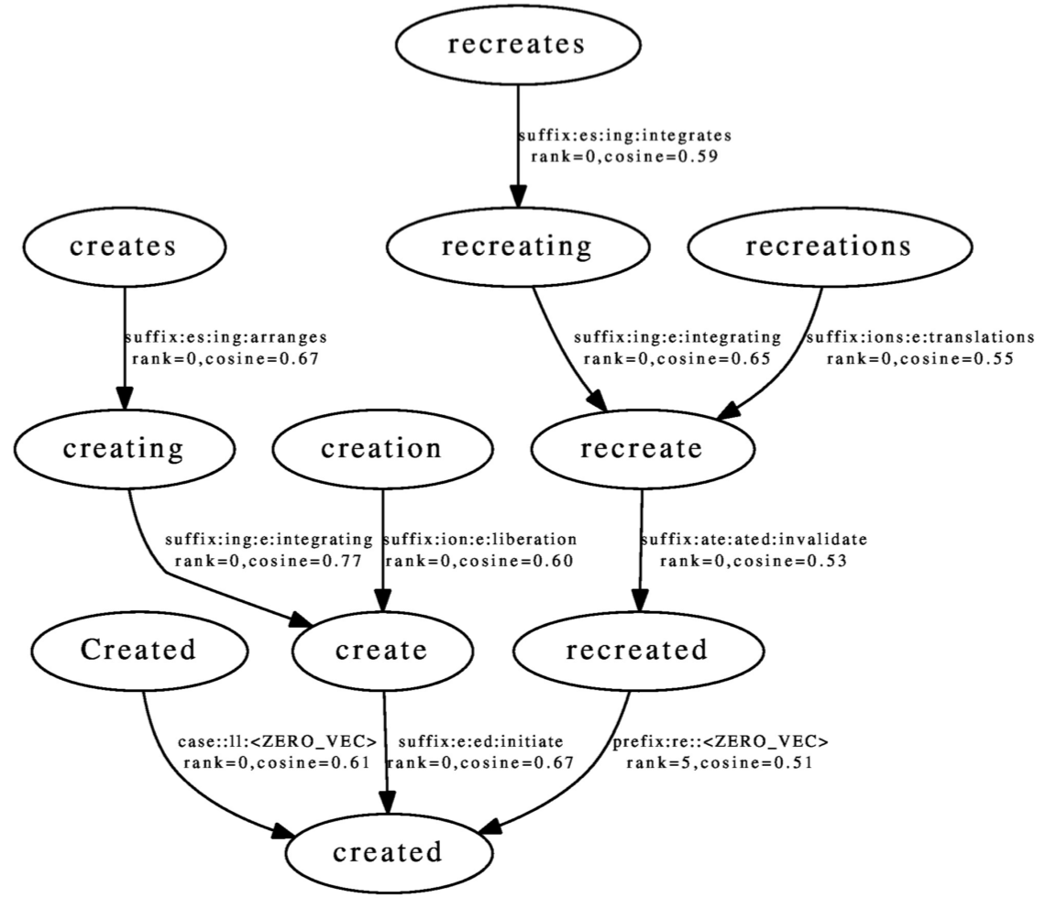
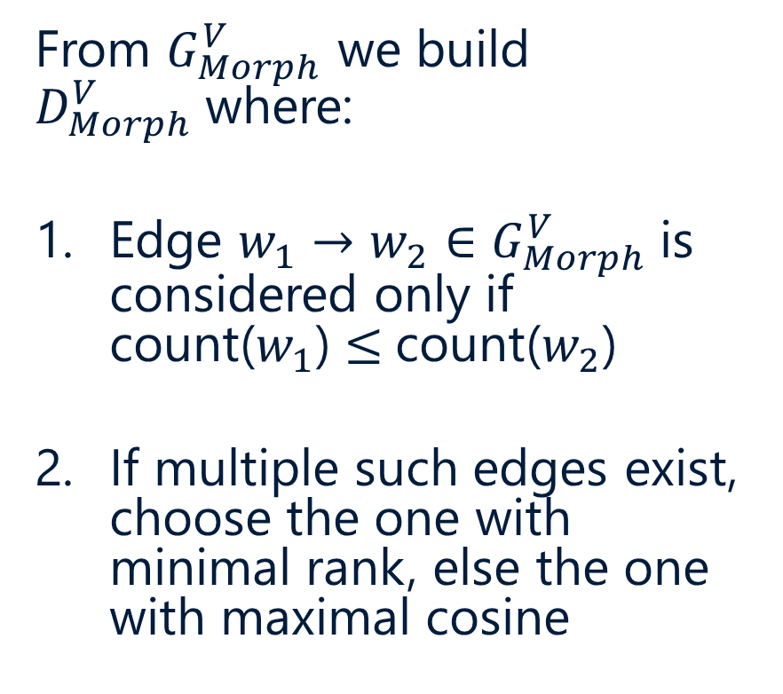
Inducing 1-to-1 Morphological Mappings
From $G_{Morph}^{V}$ we build $D_{Morph}^{V}$where:
Edge $w_{1}→w_{2}∈G_{Morph}^{V}$is considered only if count($w_{1}$) $≤$count($w_{2}$)
If multiple such edges exist, choose the one with minimal rank, else the one with maximal cosine
[7]
Notes:
Recall how a lemma represents a lexeme
Here all words are represented as transformations of “created,” which is the default.
Normally “create” would be the default, but this model favors frequency over linguistic normalization

Slide 42
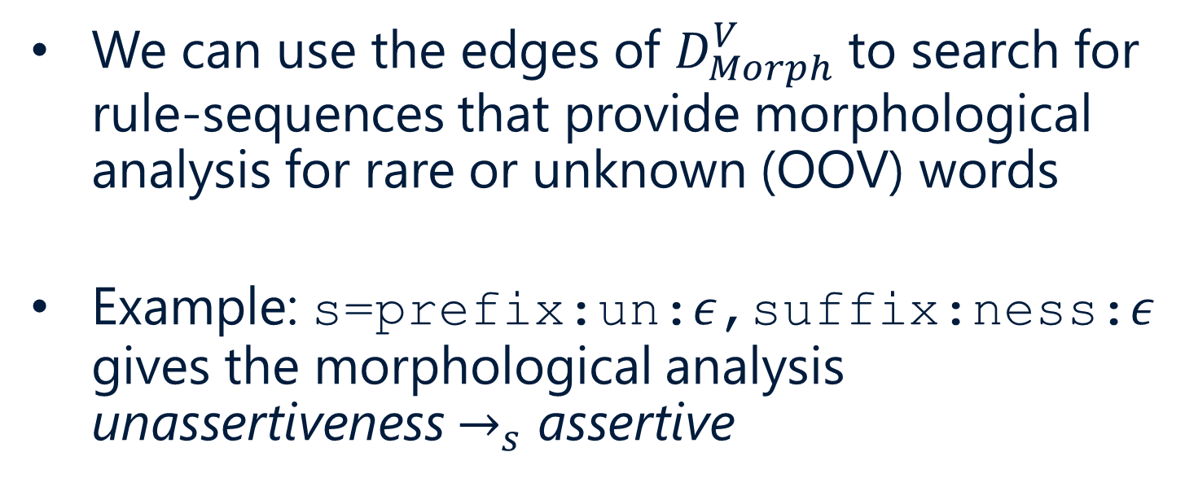
Rare/Unknown Words
We can use the edges of $D_{Morph}^{V}$to search for rule-sequences that provide morphological analysis for rare or unknown (OOV) words
Example: s=prefix:un:$ε$,suffix:ness:$ε$ gives the morphological analysis unassertiveness $→_{s}$ assertive
[7]
Notes:
If we didn’t know what unassertiveness meant, this would help us (and actually give us a word embedding for unassertiveness I think)
Also useful for rare words: if they are rare we probably don’t have enough data to understand so well what exactly they mean
We can effectively treat rare words as OOV.

Slide 43
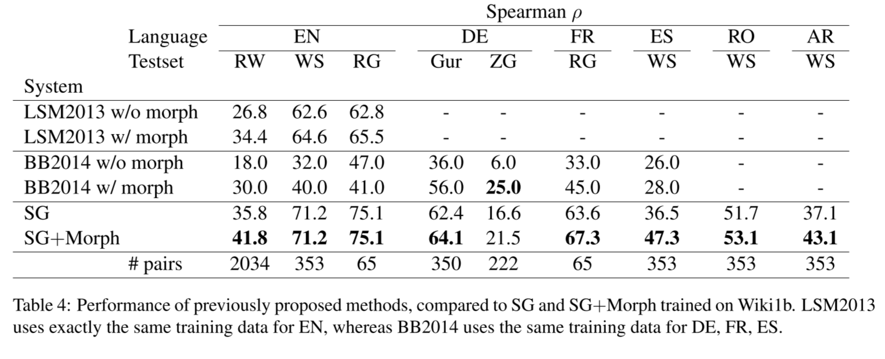
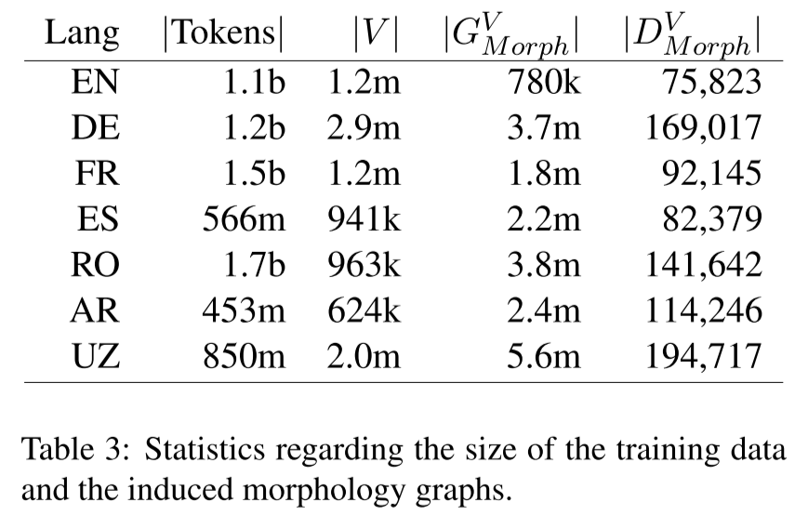
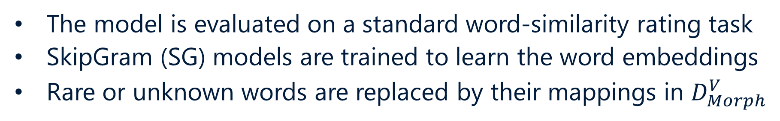
Quality of Morphological Analysis
The model is evaluated on a standard word-similarity rating task
SkipGram (SG) models are trained to learn the word embeddings
Rare or unknown words are replaced by their mappings in $D_{Morph}^{V}$
[7]
Notes:
We keep original embeddings for the known words
Notice RW (rare-word) dataset: dramatic improvement (still difficult)
For non-RW, SG and SG+Morph is identical because all words have over 100 occurrences, so no changes are made

Slide 44
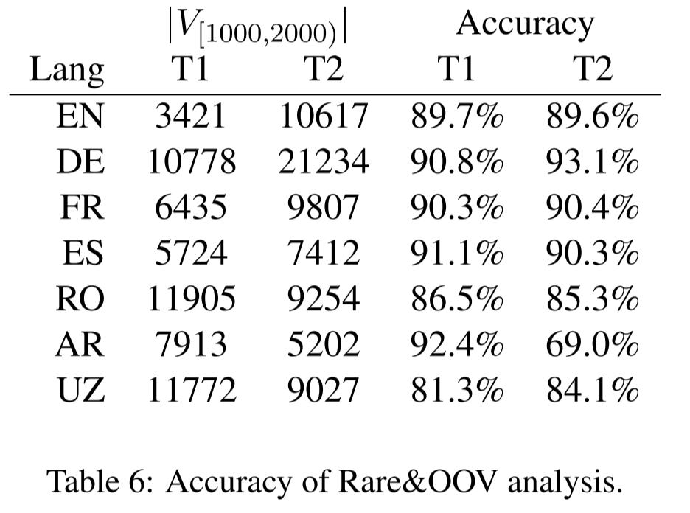
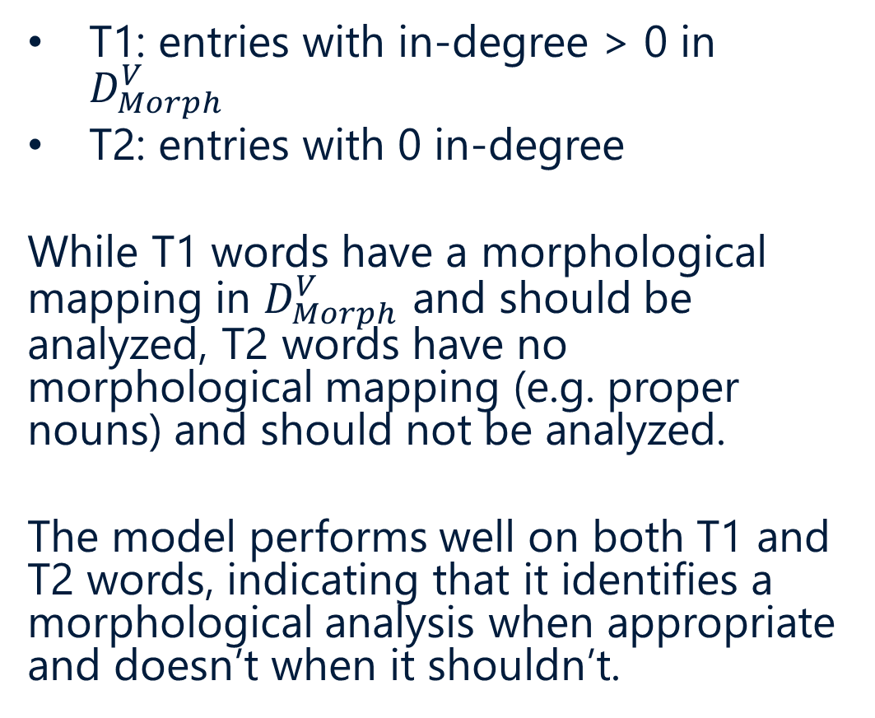
Quality of Analysis for Rare/Unknown
T1: entries with in-degree > 0 in $D_{Morph}^{V}$
T2: entries with 0 in-degree
While T1 words have a morphological mapping in $D_{Morph}^{V}$ and should be analyzed, T2 words have no morphological mapping (e.g. proper nouns) and should not be analyzed.
The model performs well on both T1 and T2 words, indicating that it identifies a morphological analysis when appropriate and doesn’t when it shouldn’t.
[7]

Slide 45
Recap
The model learns morphological rules from scratch, regardless of language
It is particularly useful for rare and unknown words
In the future it can be used to model low-resource and morphologically rich languages
[7]
Notes:
Any questions?

Slide 46
Conclusion

Slide 47
Discussion
What are some NLP tasks that would benefit from incorporating morphological information?
Can anyone who speaks a foreign language explain how morphology applies to that language?
The last paper can only model prefix and suffix-based morphological transformations:
What types of morphological transformations are not captured?
How might we generalize the model to include other kinds of transformations?
Notes:
One drawback: it is restricted to prefix and suffix-based morphology, which doesn’t capture word-compounds in German, stem changes in Spanish, etc.

Slide 48
References
Cotterell and Heigold – Cross-lingual, Character-Level Neural Morphological Tagging
Goldberg, Yoav – A Primer on Neural Network Models for Natural Language Processing
Hana, Jirka – Basics of Morphology
Hana and Feldman – Tagsets, Corpora Annotation
Oflazer, Kemal – Morphology
Olah, Christopher – Understanding LSTM Networks
Soricut and Och – Unsupervised Morphology Induction Using Word Embeddings
See the Google Drive for additional resources.

Slide 49
Thank You

Slide 50
ANLP

